Slide 1




Coupon Recommendation Analysis
Improving customer satisfaction with coupon recommendations

Slide 2



Gather Your Research using Researcher
1
2
1. Problem statement: Mechanical Turk wants to send coupons to customers that they will actually use. But it's hard to know which coupons each customer will like, because everyone is different.
2. Goal: To develop a model that can predict whether a customer will accept a coupon, based on their demographic and behavioral data.

Slide 3
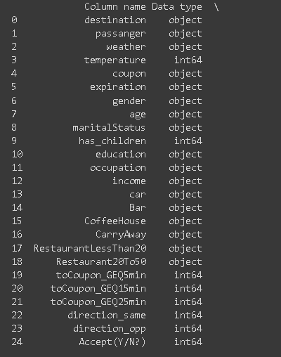
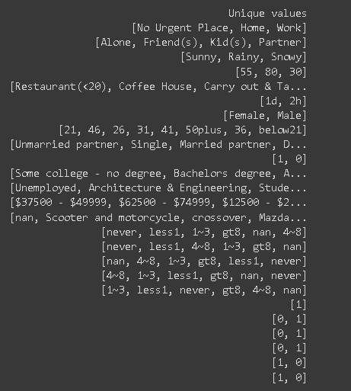
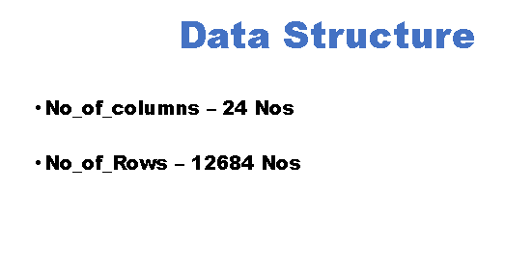
Slide 3
3
The data dictionary is a valuable resource for understanding the data in a dataset. It provides information about the data types, unique values, and other relevant details for each column. This information can be used to answer questions about the data, such as:
What percentage of the users are female?
What is the average age of the users?
What are the most common values for the "Occupation" column?
How many rows are in the dataset?
The data dictionary can also be used to identify any potential problems with the data, such as missing values or incorrect data types. This information can be used to improve the quality of the data and make it more reliable.
4

Slide 4
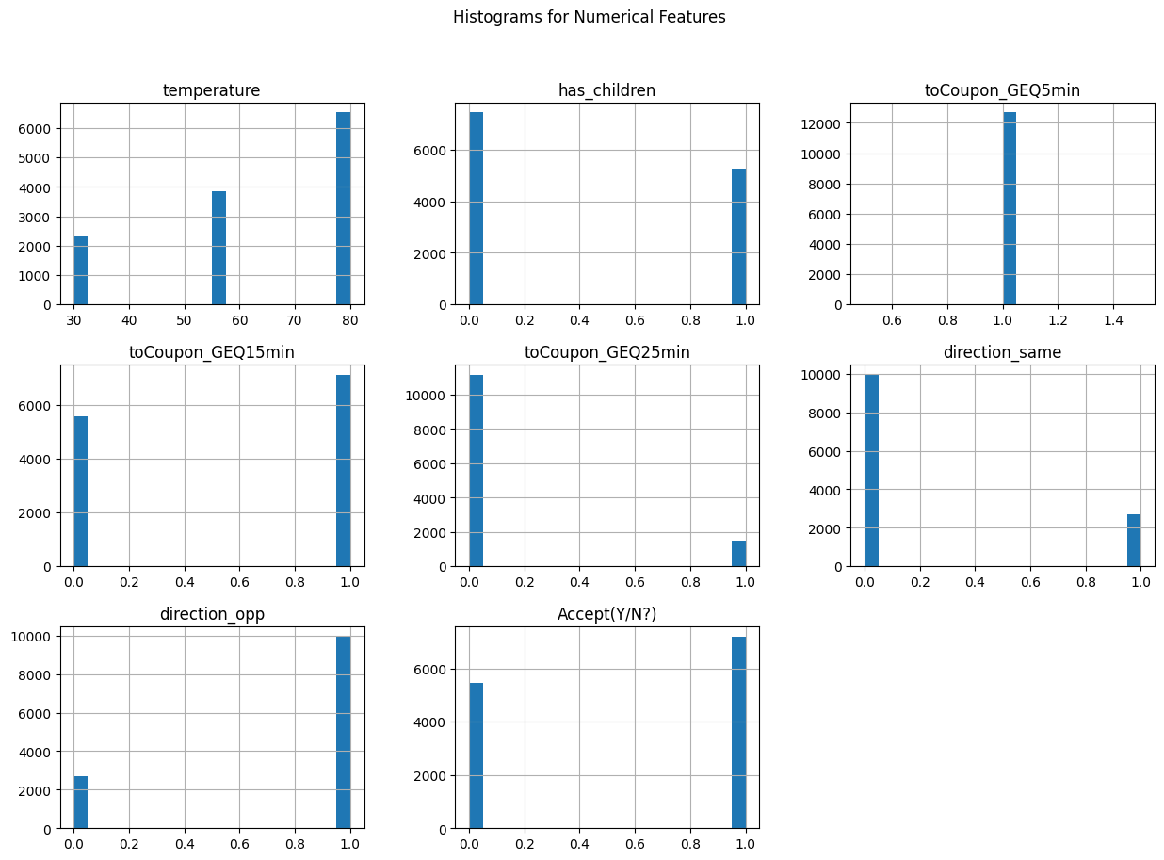
Visualizing Data
The temperature feature is normally distributed, with the most common value being around 70 degrees Fahrenheit.
The has_children feature is binary, with most users having no children.
The toCoupon_GEQ5min and toCoupon_GEQ15min features are both right-skewed, which means that there are more users who are willing to accept a coupon for a shorter driving distance.
Notes:
After consulting a variety of sources, you will need to narrow your topic. For example, the topic of internet safety is huge, but you could narrow that topic to include internet safety in regards to social media apps that teenagers are using heavily. A topic like that is more specific and will be relevant to your peers. Some questions to think about to help you narrow your topic:
What topics of the research interest me the most?
What topics of the research will interest my audience the most?
What topics will the audience find more engaging? Shocking? Inspiring?

Slide 5
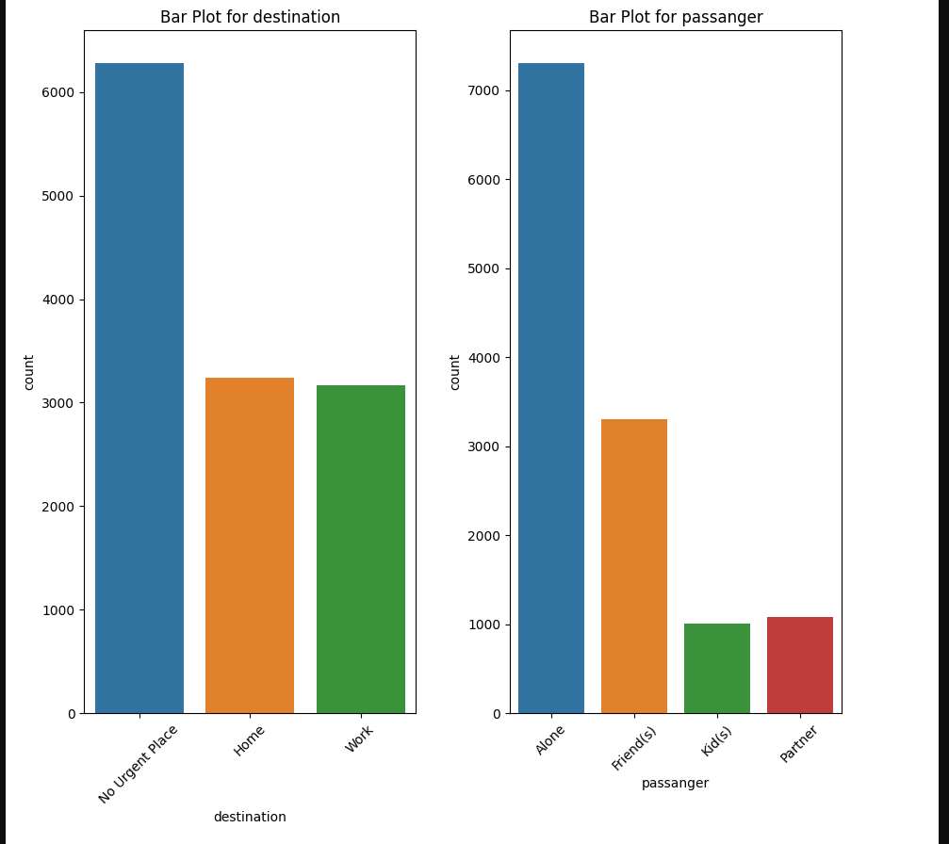
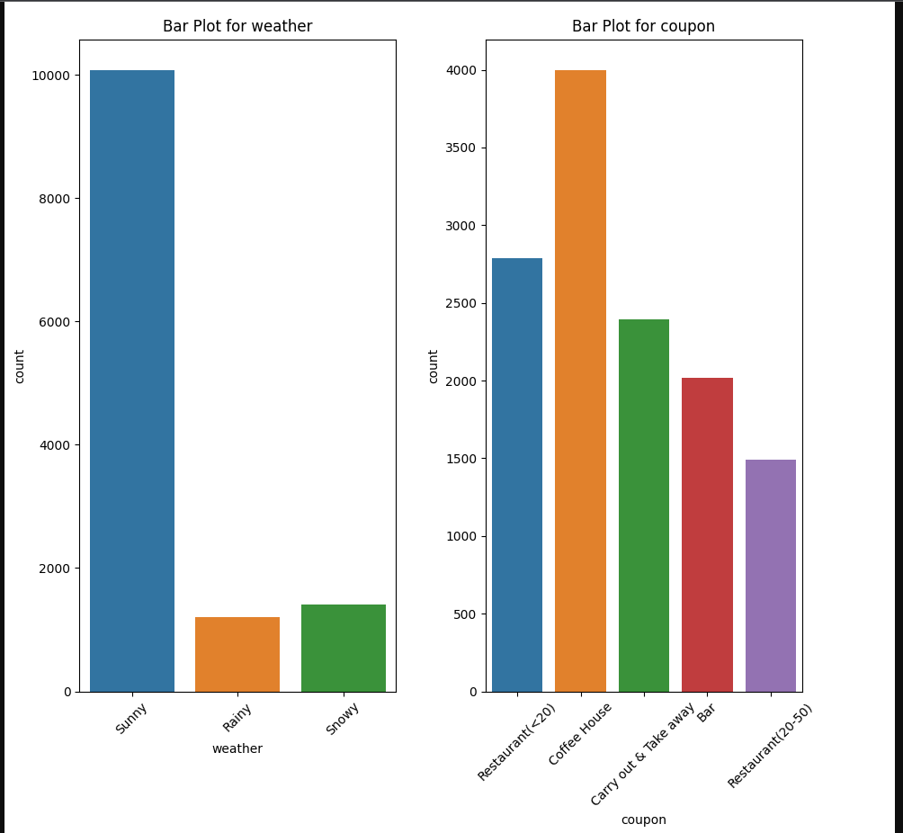
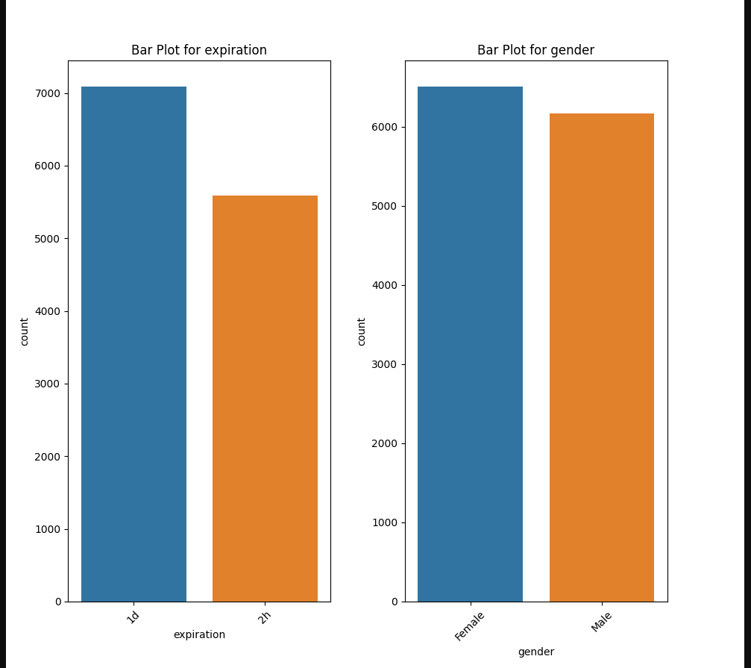


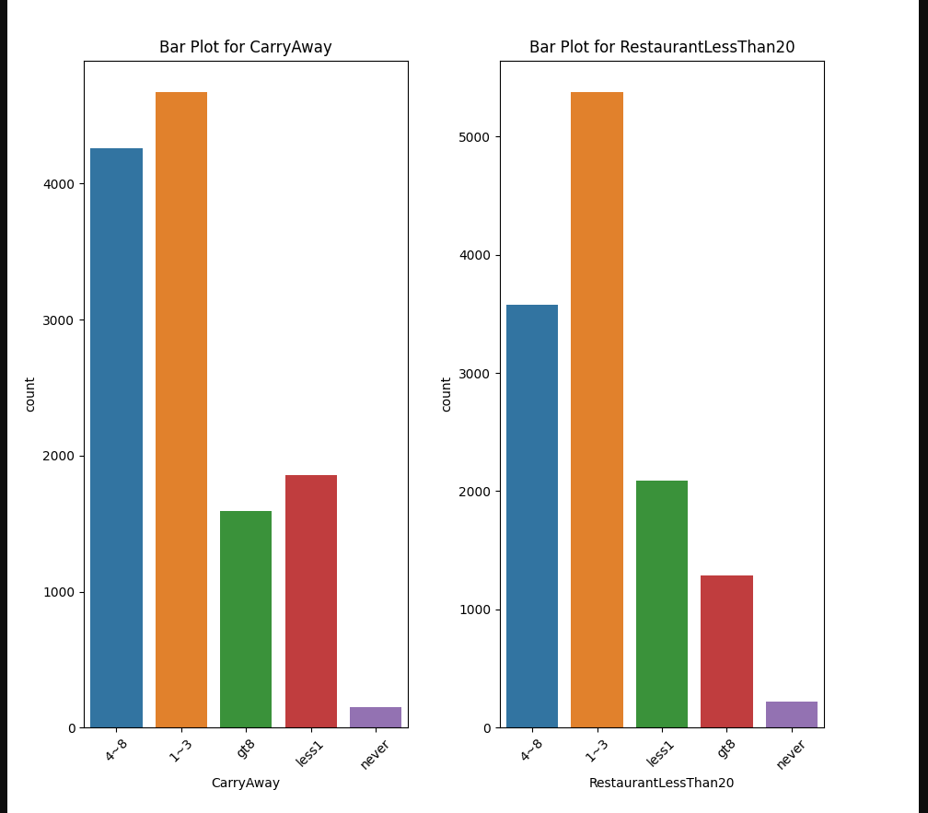

Slide 6
Insights by looking at the graphs
People who have been to a bar/coffee shop in the past year are more likely to go again. People who have never been to a bar/coffee shop in the past year are a large potential market.
The image shows a bar plot of the number of people who have been to a bar or coffee shop in the past year, divided into two categories: never and less than 1 time.
The bar for "less than 1 time" is much taller than the bar for "never", which indicates that most people have been to a bar or coffee shop in the past year at least once. However, the bar for "never" is still significant, which indicates that there is a large potential market for bars and coffee shops.
Notes:
After consulting a variety of sources, you will need to narrow your topic. For example, the topic of internet safety is huge, but you could narrow that topic to include internet safety in regards to social media apps that teenagers are using heavily. A topic like that is more specific and will be relevant to your peers. Some questions to think about to help you narrow your topic:
What topics of the research interest me the most?
What topics of the research will interest my audience the most?
What topics will the audience find more engaging? Shocking? Inspiring?

Slide 7
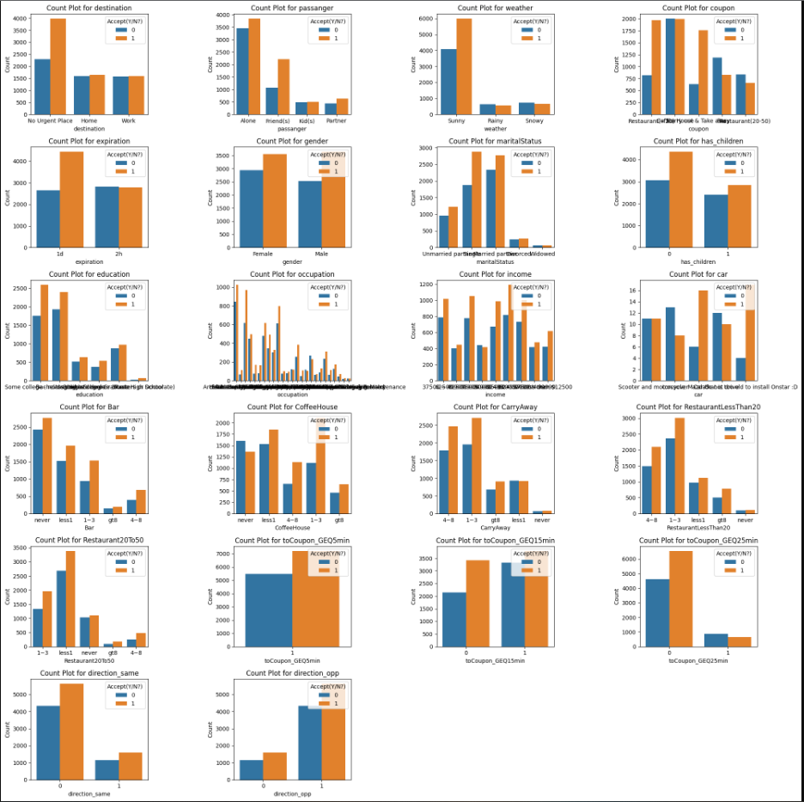

Slide 8
Insights bar graphs showing count of acceptance or not
Destination: Most coupons are used for passenger travel.
Weather: Most coupons are used on sunny days.
Coupon type: Most coupons are for restaurants.
Coupon expiration date: Most coupons are used within 1 day of their expiration date.
Coupon direction: Most coupons are used for restaurants/cafes/bars that are in the same direction as the user's current destination.
Coupon acceptance rate: Most coupons are accepted.
Notes:
After consulting a variety of sources, you will need to narrow your topic. For example, the topic of internet safety is huge, but you could narrow that topic to include internet safety in regards to social media apps that teenagers are using heavily. A topic like that is more specific and will be relevant to your peers. Some questions to think about to help you narrow your topic:
What topics of the research interest me the most?
What topics of the research will interest my audience the most?
What topics will the audience find more engaging? Shocking? Inspiring?

Slide 9
Methodology
Data Preprocessing
Data cleaning to handle missing values and outliers.
Data exploration through visualizations and statistical summaries.
Feature engineering to create relevant features.
Data splitting into training and testing sets.
Model Selection
Consideration of multiple machine learning models:
RandomForest, BaggingClassifier, SVC, DecisionTree, catboostetc.
Rational selection based on problem relevance.
Initial model evaluation using metrics such as accuracy and ROC-AUC.
Hyperparameter Tuning
Optimization of key hyperparameters:
Parameters like n_estimators, max_depth, min_samples_split, iterations, learning_rate, depth, l2_leaf_reg, etc
Utilization of grid search with cross-validation (e.g., 5-fold).
Results
Evaluation of model performance metrics:
Accuracy, precision, recall, F1-score, ROC-AUC.
Comparison of performance before and after hyperparameter tuning.
Best Model Identification
Selection of the best-performing model based on metrics.
Highlighting the hyperparameters resulting in the best model.
Emphasis on the improvements achieved through tuning.
Conclusion
Summarization of key project findings.
Notable insights or observations during the analysis.
Notes:
Now, that you have narrowed your topic, you will want to organize your research in a structure that works. There are some common organizational patterns based on the kind of research you are doing.
Organizational Structures:
Cause and Effect- this kind of structure is great for explaining the causes and effects of a topic
Compare and Contrast- in this pattern you highlight the similarities and differences of the topic
Explain process- this structure is great for outlining a series of steps to follow;
Definition- if you want to make sure your audience understands what something is using illustrations, meanings, clarifying misconceptions, you may want to use this structure
Classification- a common organizational structure is grouping like topics or facts from the research together. For instance, in the internet safety about social media apps, you may organize the research where you look at each social media app one at a time

Slide 10
Methodology
Key points of Each Step:
Data Cleaning- Handling Missing Values: Identified and handled missing values in the dataset.
Feature Engineering- Handling Categorical Data: Categorical variables were encoded into numerical form using techniques like one-hot encoding and label encoding. This was necessary for machine learning models to process the data.
Data Splitting-Divided the dataset into training and testing sets. The training set was used to train the models, while the testing set was used for model evaluation.
Model Selection-Considered a diverse set of machine learning models for the coupon recommendation task, including RandomForest, BaggingClassifier, SVC, DecisionTree, and others.
Evaluation Metrics- Assessed model performance using various evaluation metrics such as accuracy, precision, recall, F1-score, and ROC-AUC.
Hyperparameter Tuning- Grid Search: For each model, performed hyperparameter tuning using grid search. This involved specifying a range of hyperparameter values and searching for the best combination using cross-validation.
Cross-Validation- To ensure robust model evaluation, used cross-validation techniques, typically with a 5-fold setup, to account for variations in the dataset.
Notes:
Now, that you have narrowed your topic, you will want to organize your research in a structure that works. There are some common organizational patterns based on the kind of research you are doing.
Organizational Structures:
Cause and Effect- this kind of structure is great for explaining the causes and effects of a topic
Compare and Contrast- in this pattern you highlight the similarities and differences of the topic
Explain process- this structure is great for outlining a series of steps to follow;
Definition- if you want to make sure your audience understands what something is using illustrations, meanings, clarifying misconceptions, you may want to use this structure
Classification- a common organizational structure is grouping like topics or facts from the research together. For instance, in the internet safety about social media apps, you may organize the research where you look at each social media app one at a time

Slide 11
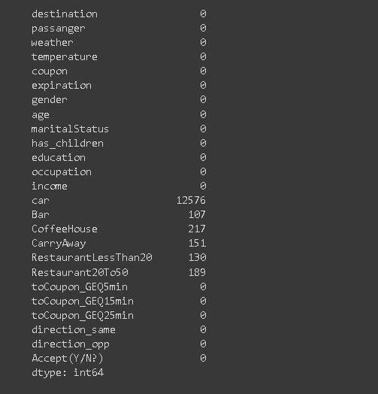
Preprocessing-Missing values present in the dataset!
Dropping columns: car, direction_same, direction_opposite, toCoupon_GEQ5min based on the EDA performed.
Notes:
When conducting research, it is easy to go to one source: Wikipedia. However, you need to include a variety of sources in your research. Consider the following sources:
Who can I interview to get more information on the topic?
Is the topic current and will it be relevant to my audience?
What articles, blogs, and magazines may have something related to my topic?
Is there a YouTube video on the topic? If so, what is it about?
What images can I find related to the topic?

Slide 12
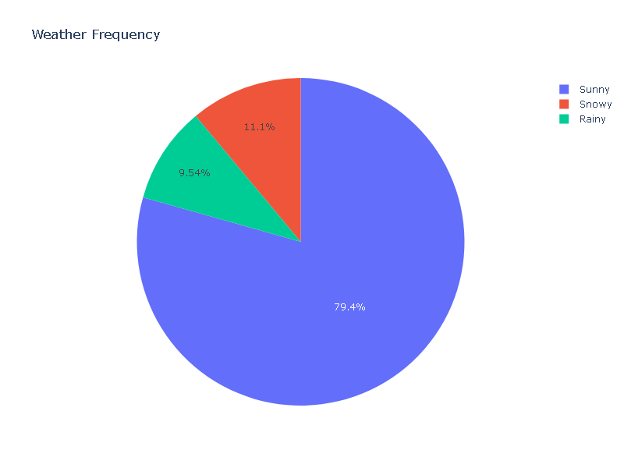
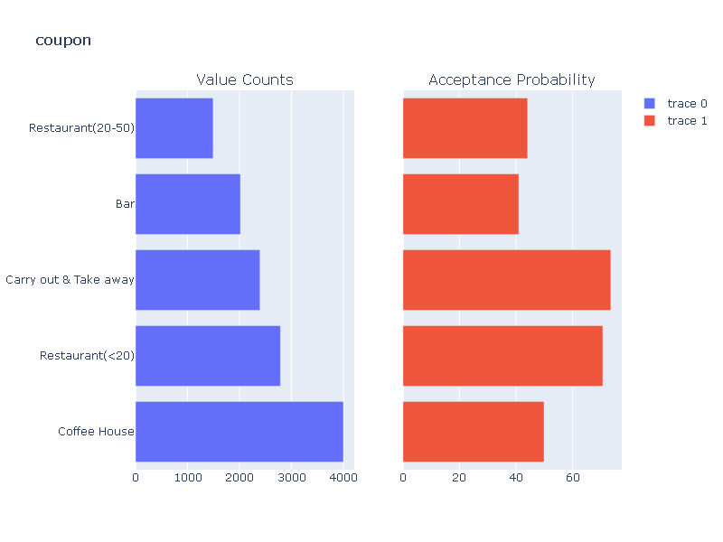
Best Features:
coupon carry out,
restaurant coupon less than 20,
weather_sunny,
passanger_friends
Notes:
When conducting research, it is easy to go to one source: Wikipedia. However, you need to include a variety of sources in your research. Consider the following sources:
Who can I interview to get more information on the topic?
Is the topic current and will it be relevant to my audience?
What articles, blogs, and magazines may have something related to my topic?
Is there a YouTube video on the topic? If so, what is it about?
What images can I find related to the topic?

Slide 13

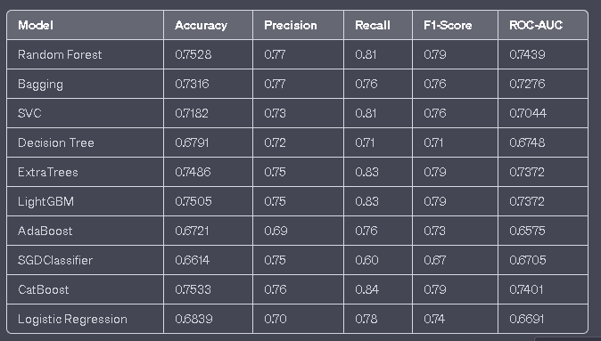
Result
These are the results for the different models before Hyperparameter Tuning
Notes:
Once you find your sources, you will want to evaluate your sources using the following questions:
Author:
Who is the author?
Why should I believe what he or she has to say on the topic?
Is the author seen as an expert on the topic? How do you know?
Current:
How current is the information in the source?
When was the source published?
Is the information out-of-date?
Accuracy:
Is the content accurate?
Is the information presented objectively? Do they share the pros and cons?

Slide 14
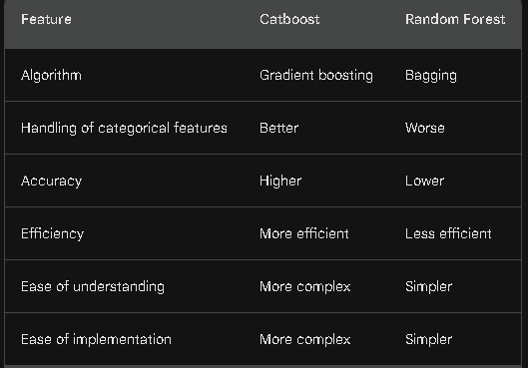
Result
Used Hyperparameter tuning for two best performing models i.e
Random Forest & Catboost
Notes:
Once you find your sources, you will want to evaluate your sources using the following questions:
Author:
Who is the author?
Why should I believe what he or she has to say on the topic?
Is the author seen as an expert on the topic? How do you know?
Current:
How current is the information in the source?
When was the source published?
Is the information out-of-date?
Accuracy:
Is the content accurate?
Is the information presented objectively? Do they share the pros and cons?

Slide 15
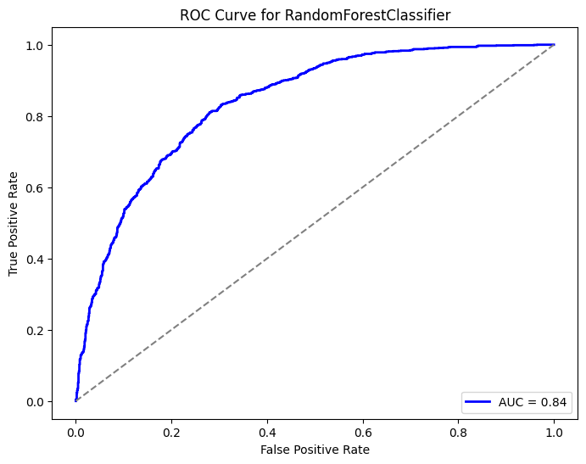
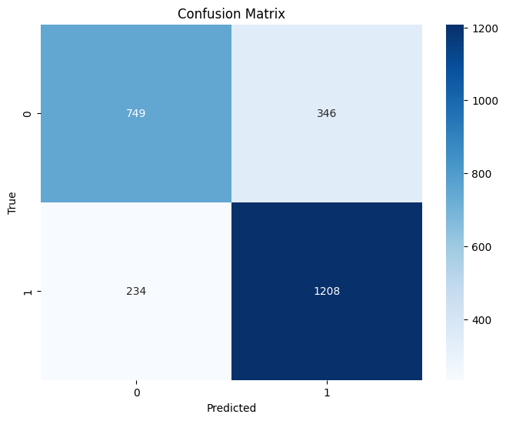
Best Model Selection
Comparing between two of them I found that Catboost is performing much better after Hyperparameter Tuning with the Accuracy of 77.13%
Notes:
After consulting a variety of sources, you will need to narrow your topic. For example, the topic of internet safety is huge, but you could narrow that topic to include internet safety in regards to social media apps that teenagers are using heavily. A topic like that is more specific and will be relevant to your peers. Some questions to think about to help you narrow your topic:
What topics of the research interest me the most?
What topics of the research will interest my audience the most?
What topics will the audience find more engaging? Shocking? Inspiring?

Slide 16
Conclusion
Project Highlights
Coupon recommendation project:
Data Refinement: Cleaned and transformed data for precise modeling.
Model Selection: Explored various models for optimal recommendations.
Hyperparameter Tuning: Fine-tuned models for peak performance.
Visual Insights: Visualized results with ROC curves for clarity.
Business Impact: Promises enhanced customer engagement and growth.
.
Notes:
After you’ve done your research, it’s time to put your presentation together. The first step in the process is to introduce the topic. This is a great time to connect your topic to something that your audience can relate. In other words, why should they listen to all the information you will be sharing in your research presentation? What is in it for them? You may also want to include a graphic or image to grab their attention.
Feel free to duplicate this slide by right-clicking on this slide in the slides pane to the left and select Duplicate Slide.
The next step in your presentation is to state your claim or topic clearly. Your teacher may even call this your thesis. As you state your thesis, you may find that this layout is not the best layout for your claim or topic. You can change the layout by clicking the drop-down menu next to the Layout in the Slides menu section. You can choose Two Content, Comparison, or Picture with Caption. Note: A different layout might change the look of the icons on this page.
You will also want to state your facts. You have done the research now share some of the interesting facts with your audience. Facts do not have to be boring; you can communicate facts in a variety of ways by going to the Insert Tab. In the Insert tab you can:
Insert pictures from your computer or online.
Add a chart
Create some SmartArt
Insert a variety of icons to help your facts come to life. Note: You can change the color of the icons by selecting the icon and then click on the Format tab and then Graphics Fill. From there, you will choose a color from the list or choose More Fill Colors to give you more options.
Since this research presentation is a result of your hard work and searching, you want to make sure you support the claims or points in your presentation with facts from your research findings. Make sure you give the author proper credit for helping you share your ideas. If one of your sources has a video that is relevant to your topic, you can add the video as added support. Keep in mind the length of the video and the amount of time you have for your presentation. For a 5 minute speech, the video should be no longer than 30 seconds.
Questions to consider:
How will you state the author of the source?
Will you need to cite the source on the slide?
What are some ways you can engage your audience so they feel like they are a part of the presentation? Some ideas to consider is by taking a quick poll like: by a show of hands, how many of you think school uniforms are a way to cut down on bullying? Another suggestion is to have them hold up a certain number of fingers to see if they agree or disagree. Finally, you can share a story that the audience can relate to that makes them laugh.
After all the applause, your audience may have some questions. Be prepared to answer some of their questions by making a list of questions you think they might ask. You may also want to share the presentation with them by providing the link to your presentation, if they want more information.

Slide 17
Thank you for your Time
Notes:
You can use this slide as your opening or closing slide. Should you choose to use it as a closing, make sure you review the main points of your presentation. One creative way to do that is by adding animations to the various graphics on a slide. This slide has 4 different graphics, and, when you view the slideshow, you will see that you can click to reveal the next graphic. Similarly, as you review the main topics in your presentation, you may want each point to show up when you are addressing that topic.
Add animation to images and graphics:
Select your image or graphic.
Click on the Animations tab.
Choose from the options. The animation for this slide is “Split”. The drop-down menu in the Animation section gives even more animations you can use.
If you have multiple graphics or images, you will see a number appear next to it that notes the order of the animations.
Note: You will want to choose the animations carefully. You do not want to make your audience dizzy from your presentation.

